Slide 1


Slide 2

ONLINE
ADVERTISING DATA ANALYSIS WITH
PYTHON

Slide 3
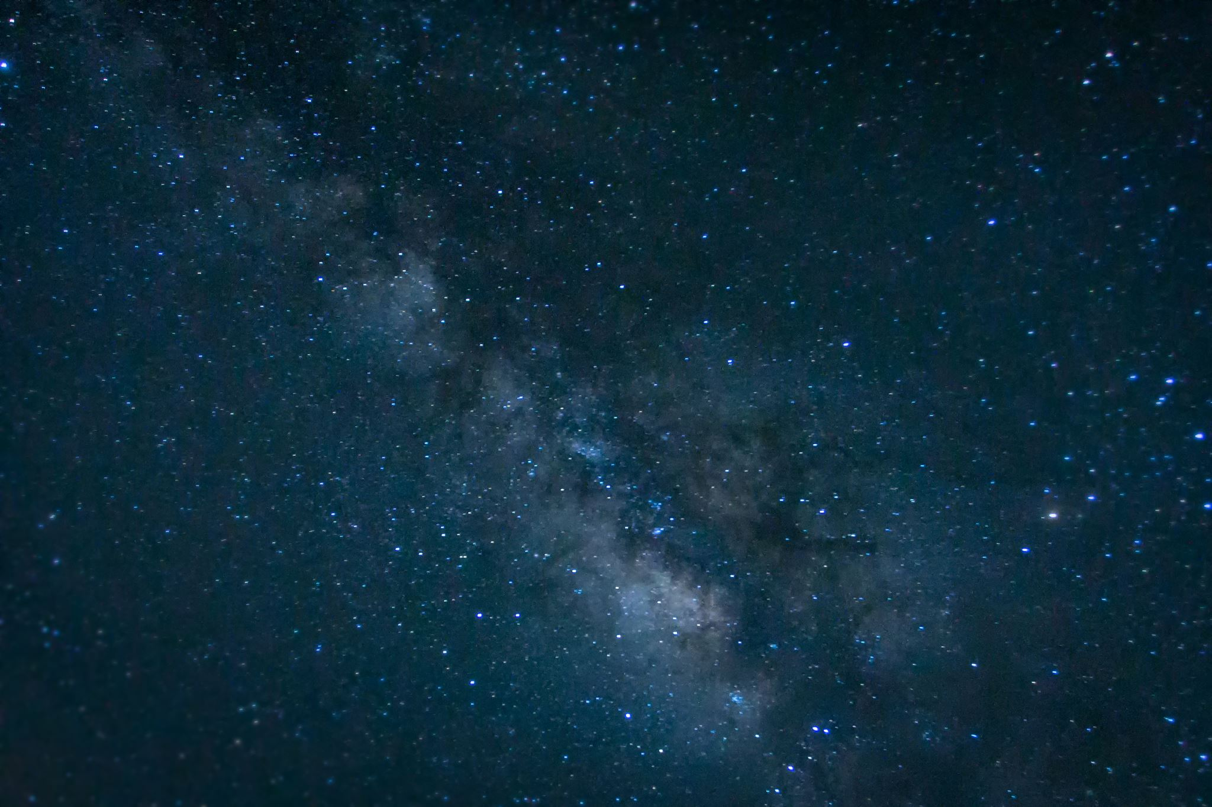
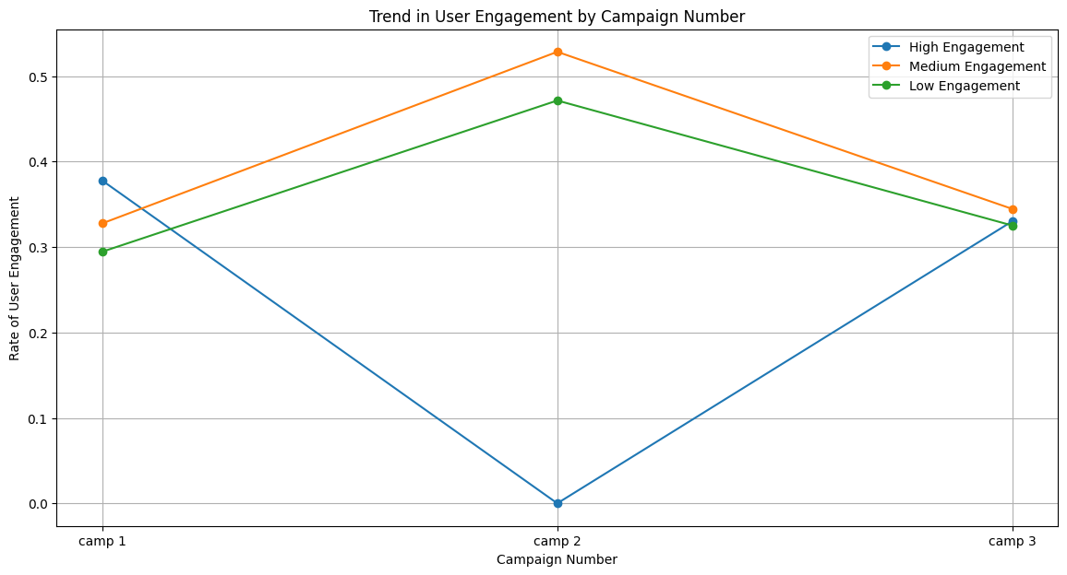
QUESTION1. WHAT IS THE OVERALL TREND IN USER ENGAGEMENT THROUGHOUT THE CAMPAIGN PERIOD?

Slide 4

Here, the above graph clearly shows that the highest user engagement rate in Campaign No.1 and Campaign No.3 is quite lesser than Campaign No.1 and Campaign No.2 has the lowest high engagement of users. Data shows Campaign No.3 has performed moderately well compared to Campaign No.1 and Campaign No.2 is a much better performer in terms of Low and Medium user engagement levels.

Slide 5
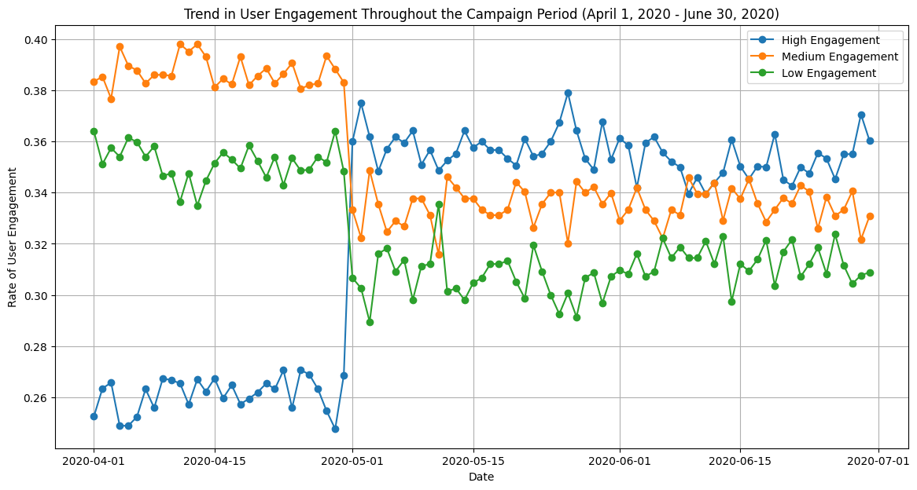
Another Way Of Visualization

Slide 6
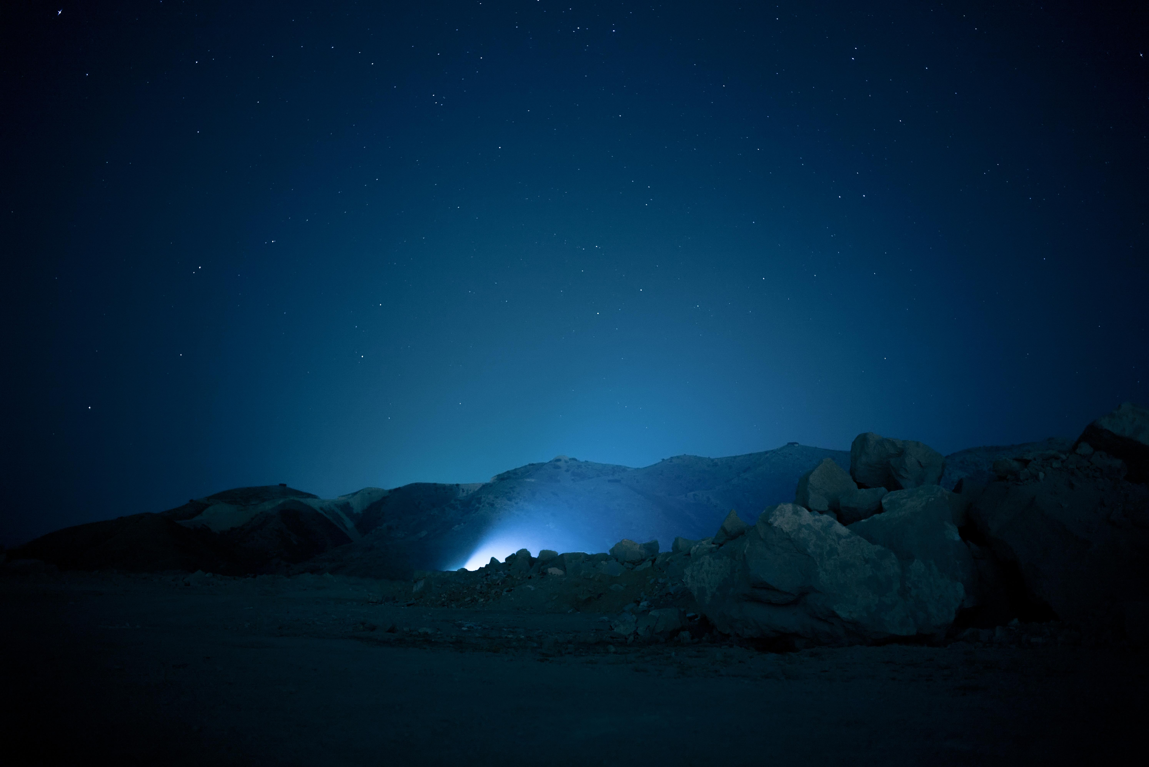
Here, the graph depicts that during April and 1st week of May, the high engagement of users was much lesser than Low and Medium user engagement and after that, it rapidly increased from 1st week of May and is going on more or less the same level up to June,2020. Moreover, High engagement levels comparatively more than low and medium user engagement during this time.

Slide 7
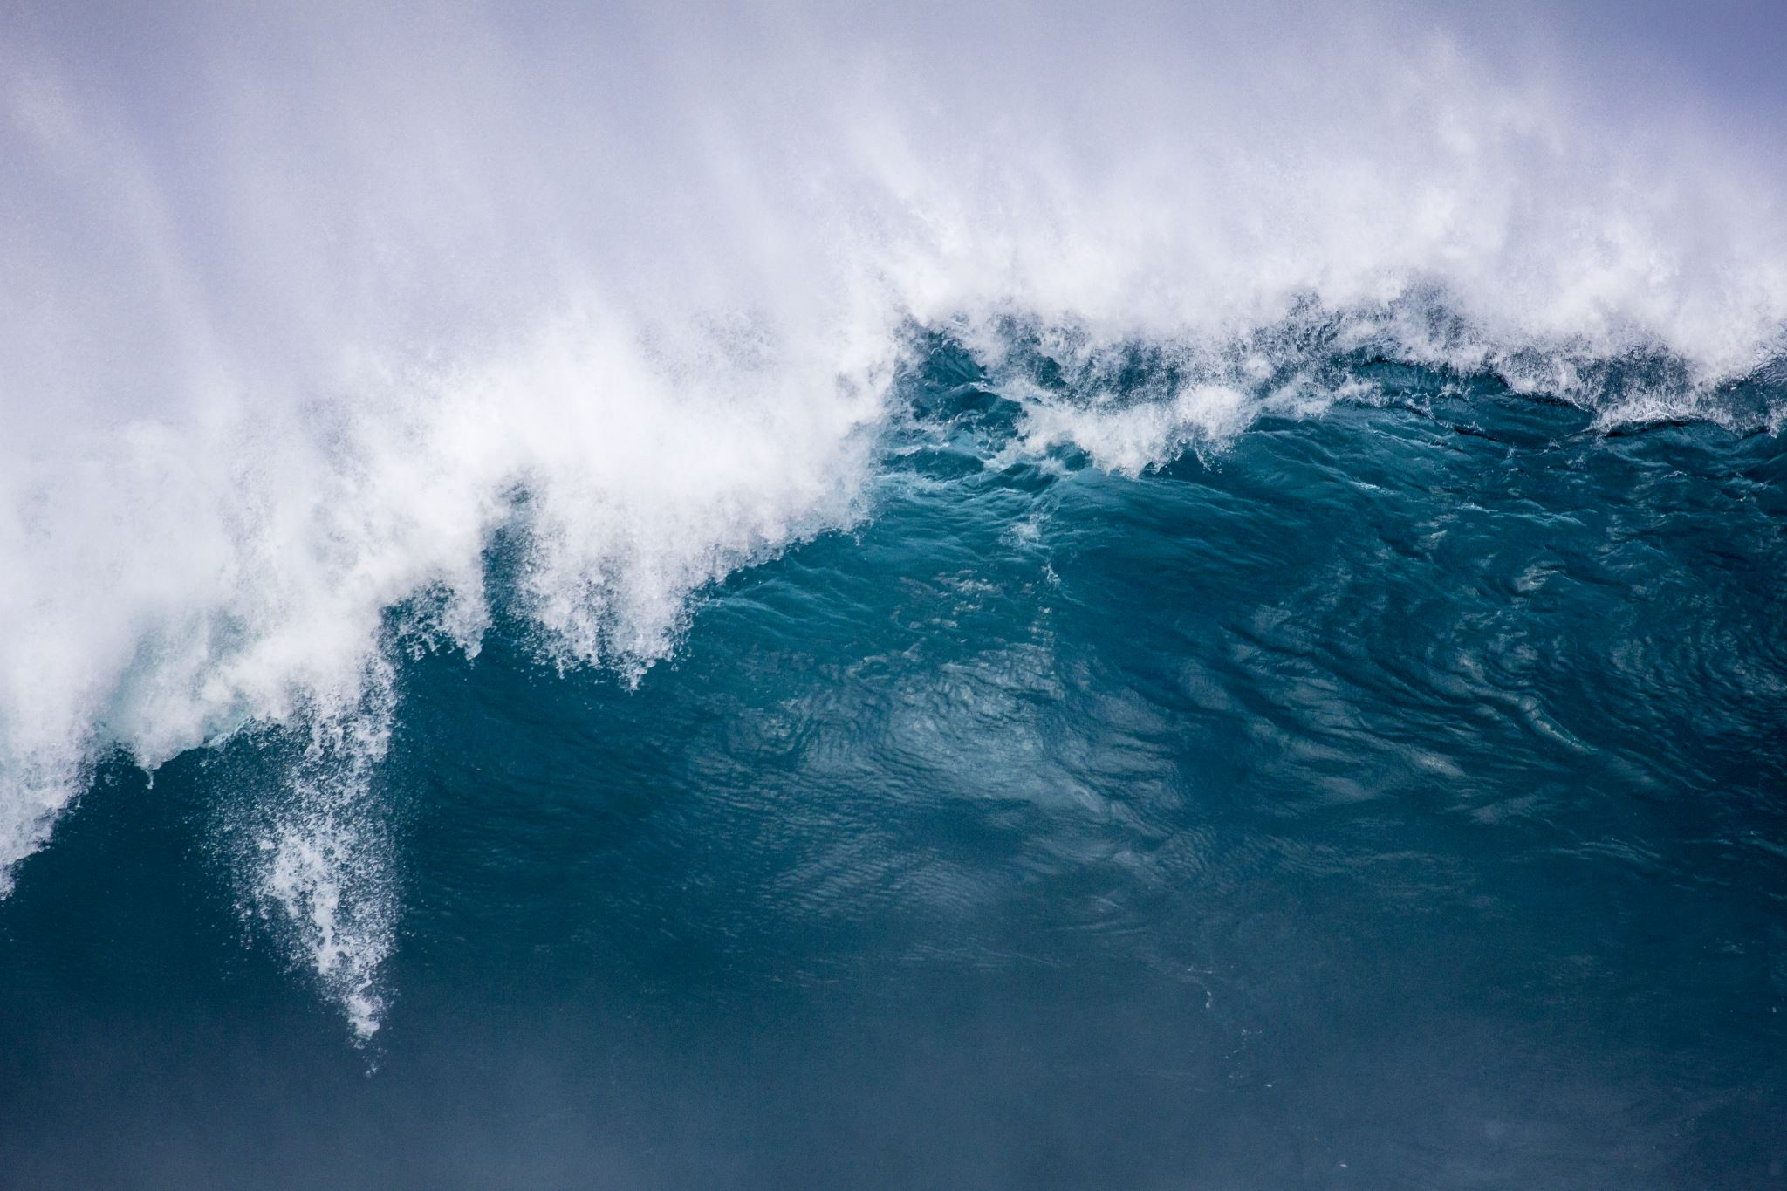
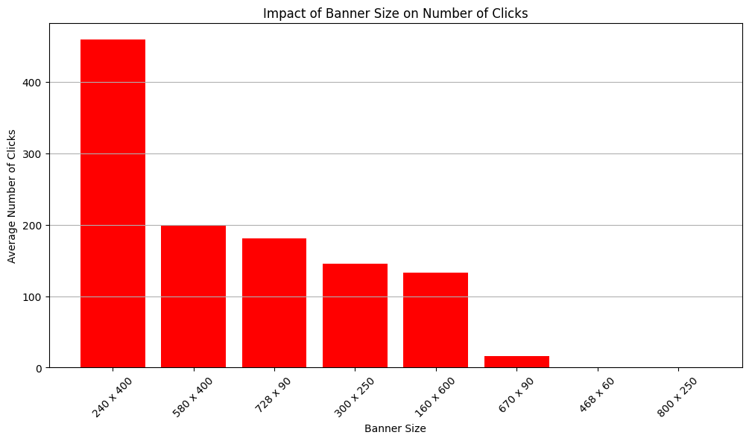
Question 2. How does the size of the ad (banner) impact the number of clicks generated?
It shows the banner size 240x400 has the highest number of user clicks and the banner size 800 x 250 has the lowest number of clicks.

Slide 8

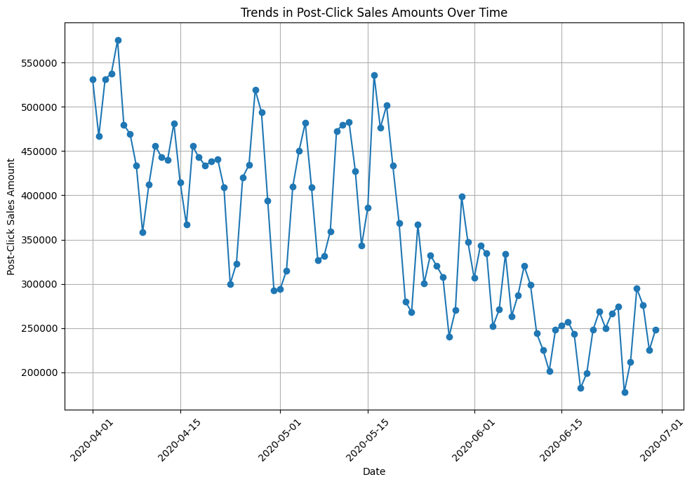
QUESTION 7. ARE THERE ANY SPECIFIC TRENDS OR PATTERNS IN POST-CLICK SALES AMOUNTS OVER TIME?
Here the trends show that click sales amount is literally high in April to middle of May.

Slide 9
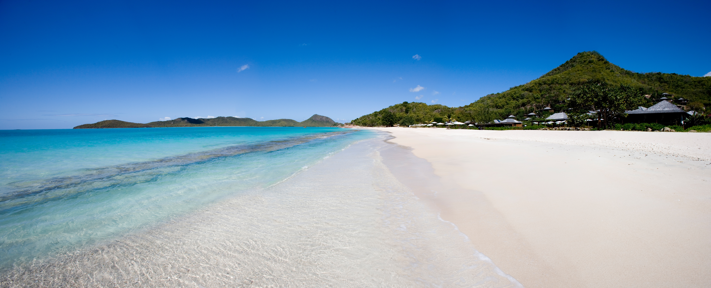
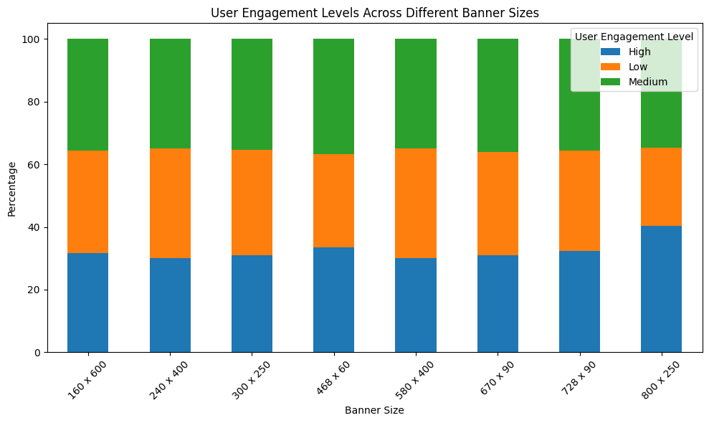
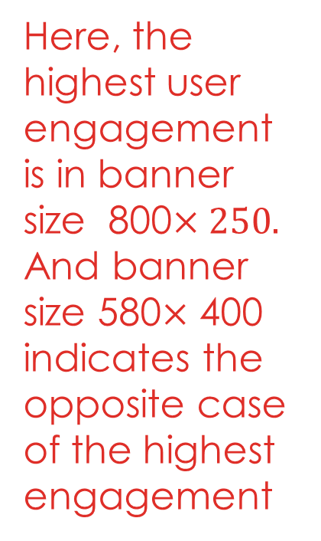
QUESTION 8. HOW DOES THE LEVEL OF USER ENGAGEMENT VARY ACROSS DIFFERENT BANNER SIZES?
Here, the highest user engagement is in banner size 800$×250.$ And banner size 580$×$ 400 indicates the opposite case of the highest engagement

Slide 10
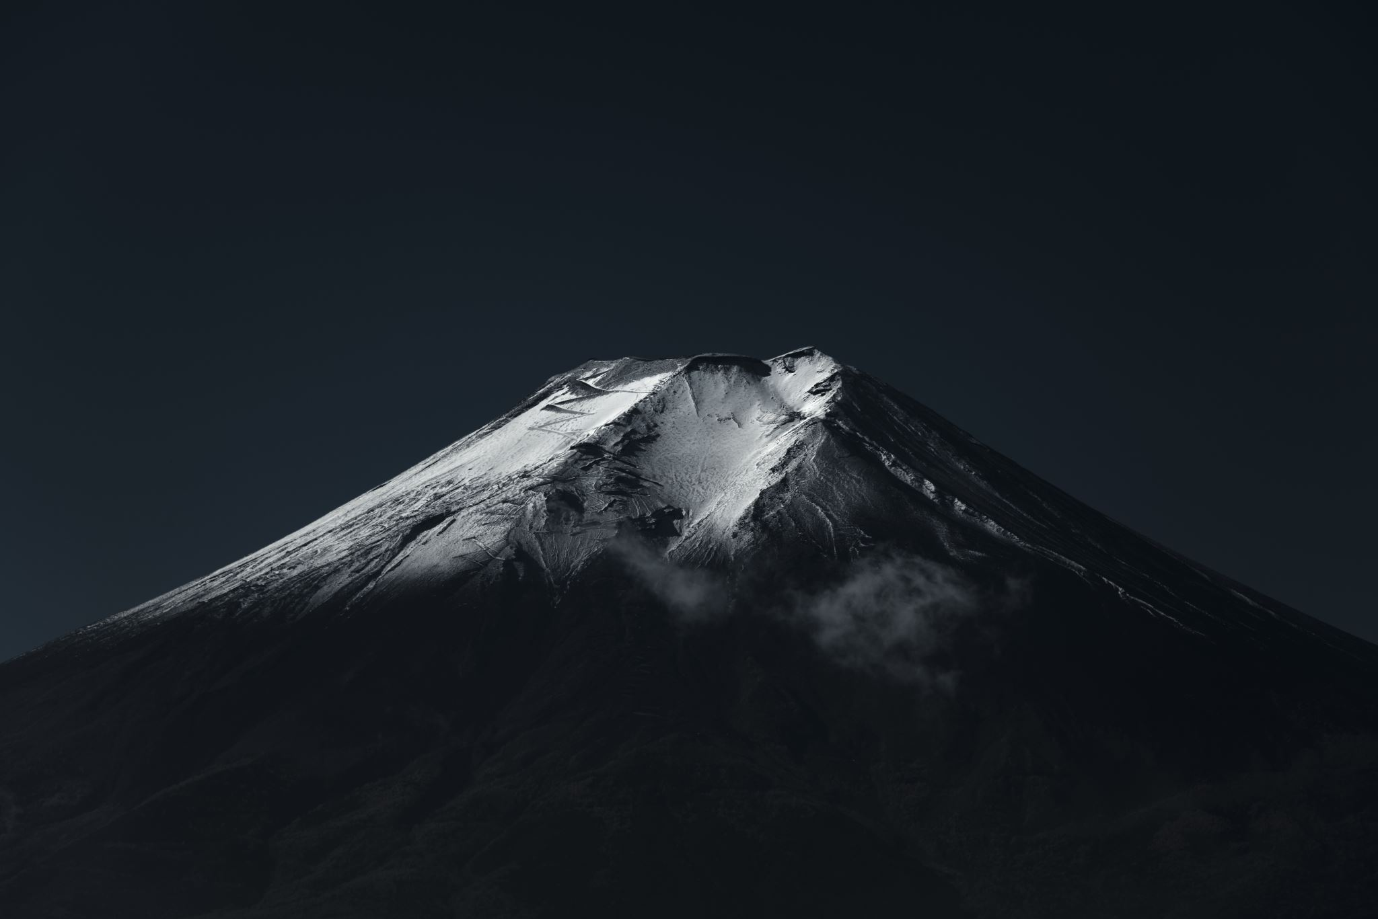
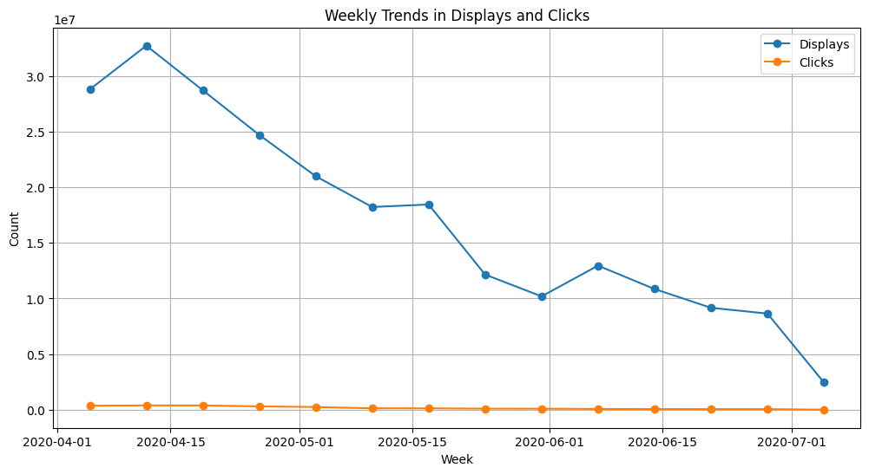
QUESTION 10. CAN WE IDENTIFY ANY SEASONAL PATTERNS OR FLUCTUATIONS IN DISPLAYS AND CLICKS THROUGHOUT THE CAMPAIGN PERIOD?
Here, the picture clearly shows that weekly trends in Displays quietly decline from April to June. On the other hand, the trend of the number of clicks is more or less at a constant level.

Slide 11
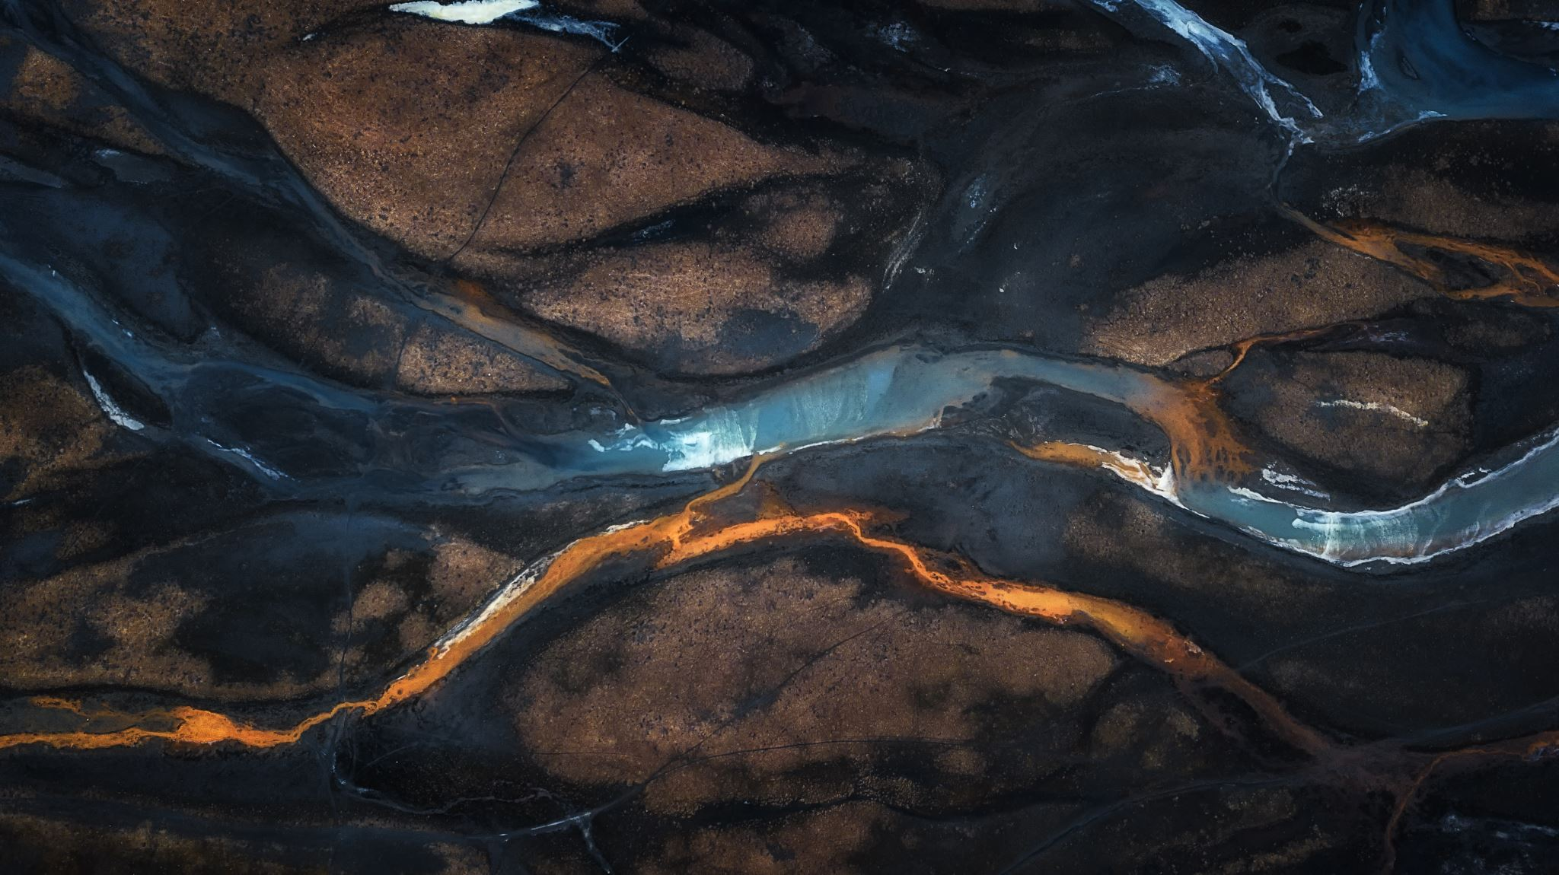
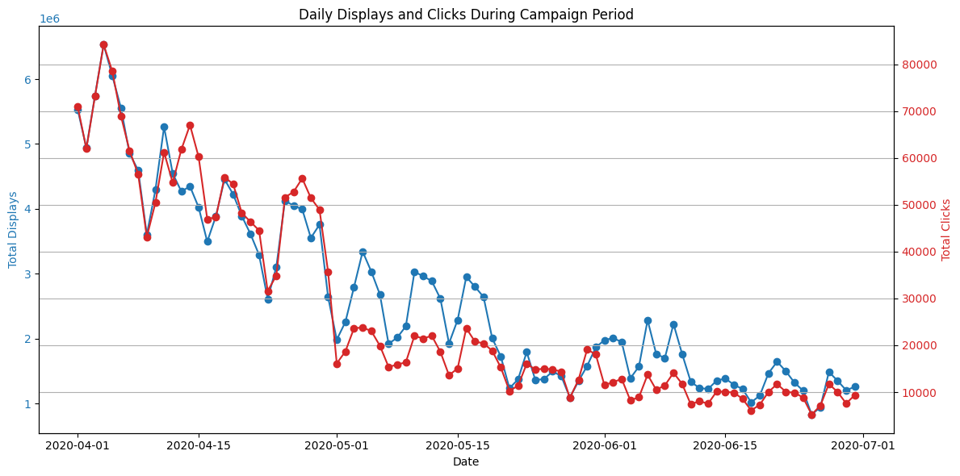
The second part is on daily basis where both display and clicks are in seasonal trends and their behavior is quite similar to each other.

Slide 12

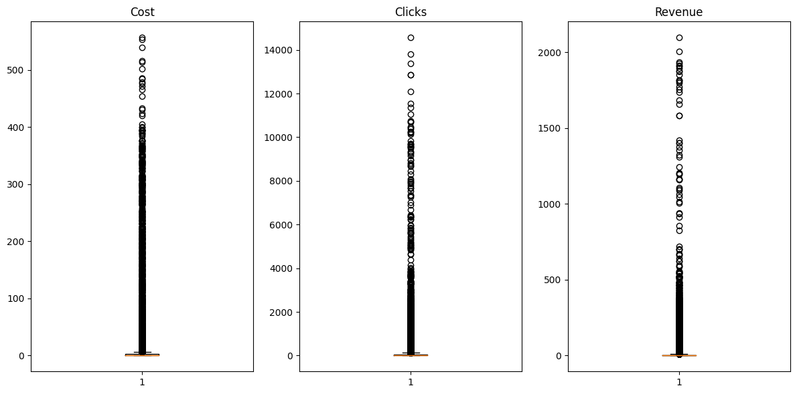
QUESTION 12. ARE THERE ANY OUTLIERS IN TERMS OF COST, CLICKS, OR REVENUE THAT WARRANT FURTHER INVESTIGATION?
Yes, There are outliers in terms of cost, clicks, or revenue that warrant further investigation and i.e. crucial for every analyst.

Slide 13

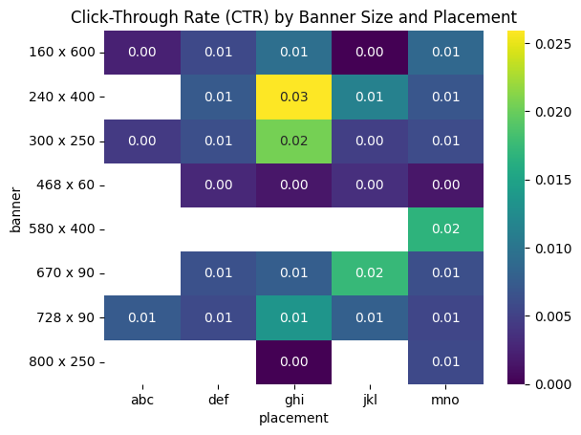
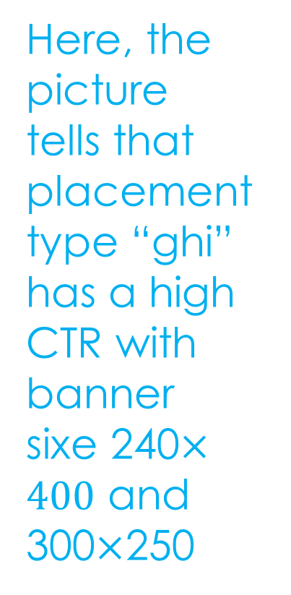
QUESTION13. HOW DOES THE EFFECTIVENESS OF CAMPAIGNS VARY BASED ON THE SIZE OF THE AD AND PLACEMENT TYPE?
Here, the picture tells that placement type “ghi” has a high CTR with banner sixe 240$×400$ and 300$×$250

Slide 14
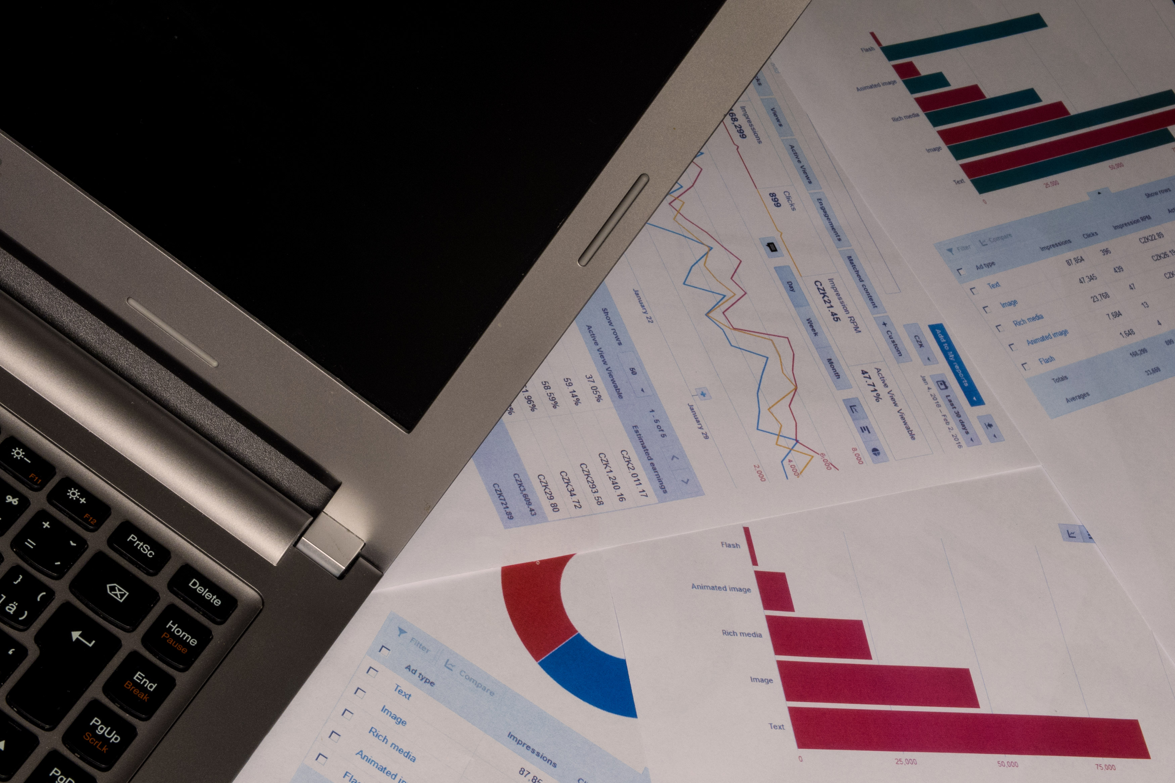
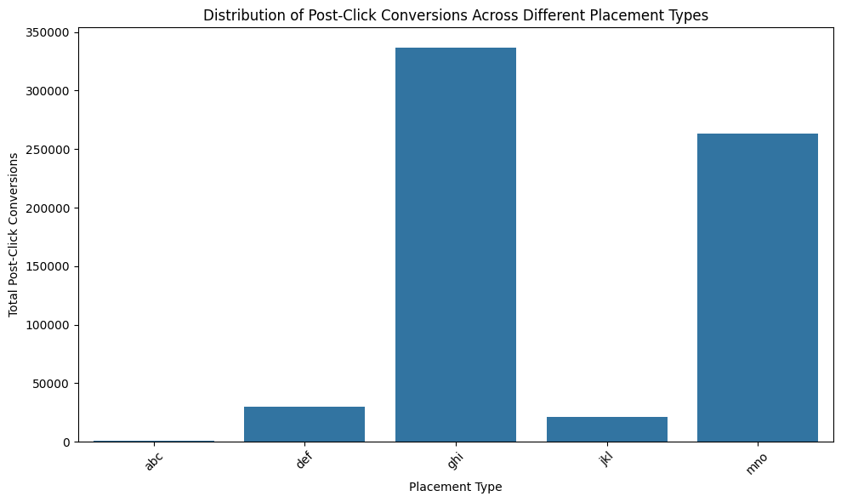
Q15. WHAT IS THE DISTRIBUTION OF POST-CLICK CONVERSIONS ACROSS DIFFERENT PLACEMENT TYPES?
Here, placement type “ghi” has the highest total post-click conversions and “abc” has the lowest total post-click conversions.

Slide 15

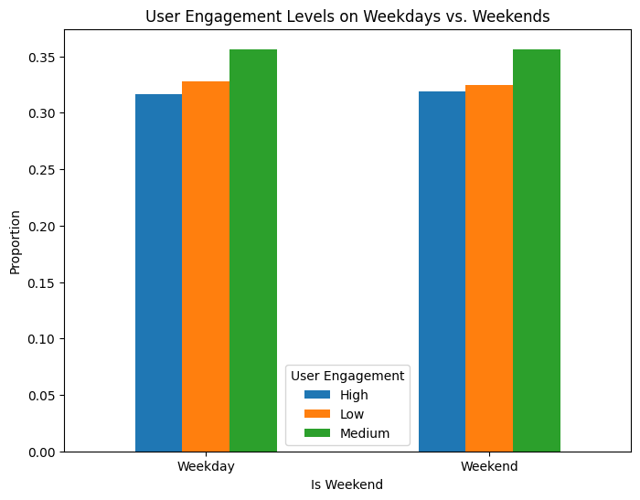
QUESTION 16. ARE THERE ANY NOTICEABLE DIFFERENCES IN USER ENGAGEMENT LEVELS BETWEEN WEEKDAYS AND WEEKENDS?
Hence, There is not so much noticeable differences in user engagement levels between weekdays and weekends.

Slide 16
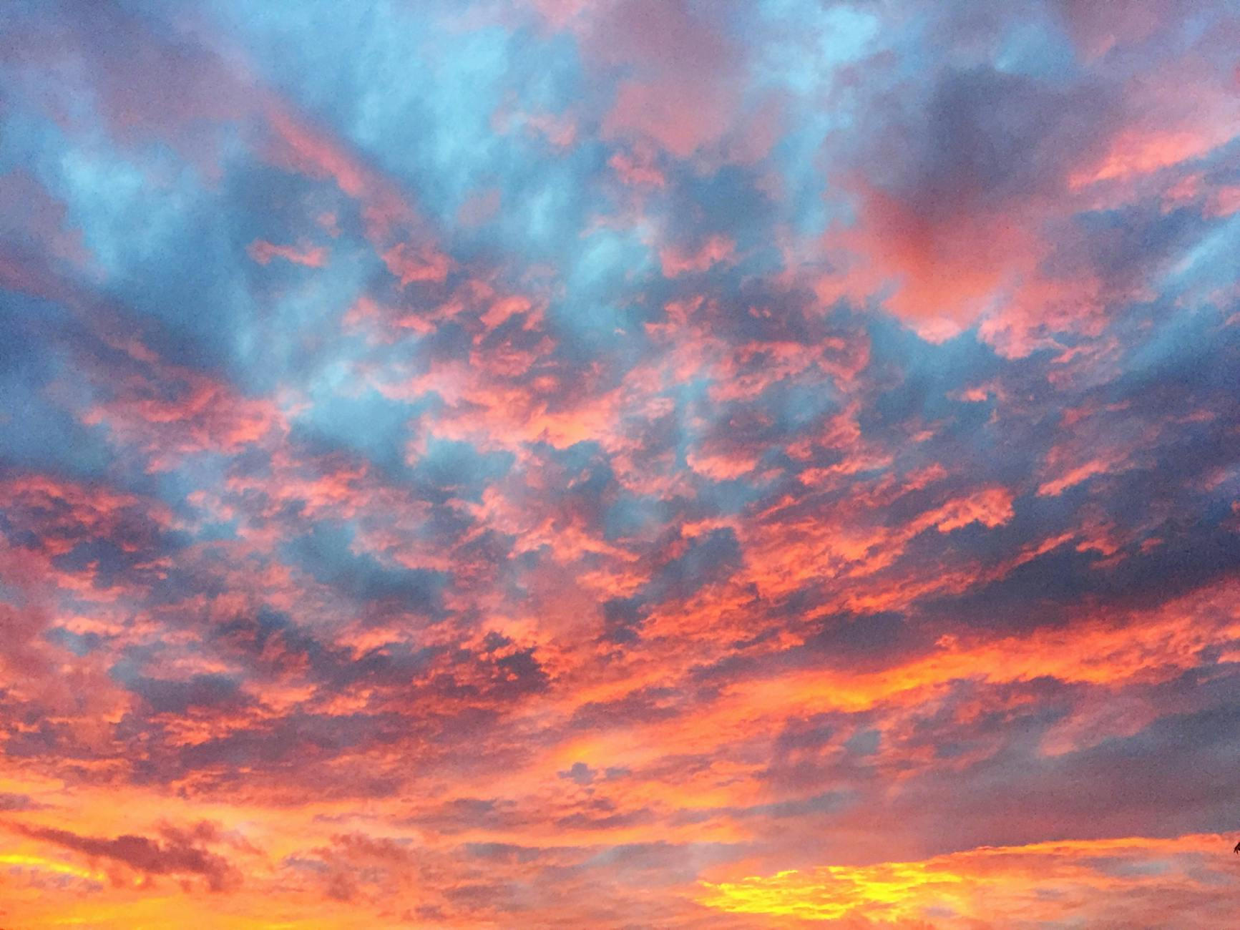
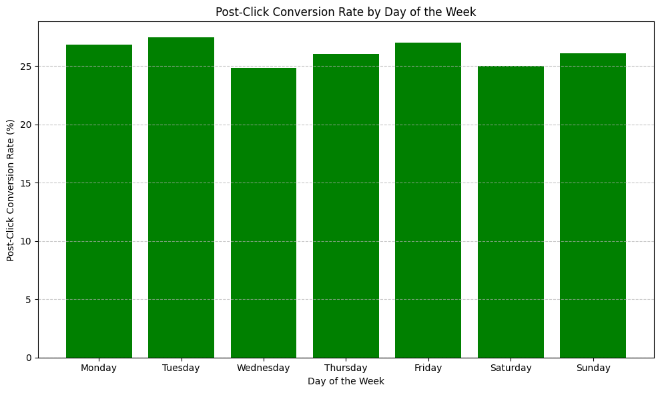
Q19. CAN WE IDENTIFY ANY TRENDS OR PATTERNS IN POST-CLICK CONVERSION RATES BASED ON THE DAY OF THE WEEK?
There are very low trends or patterns in post-click conversion rates based on the day of the week

Slide 17

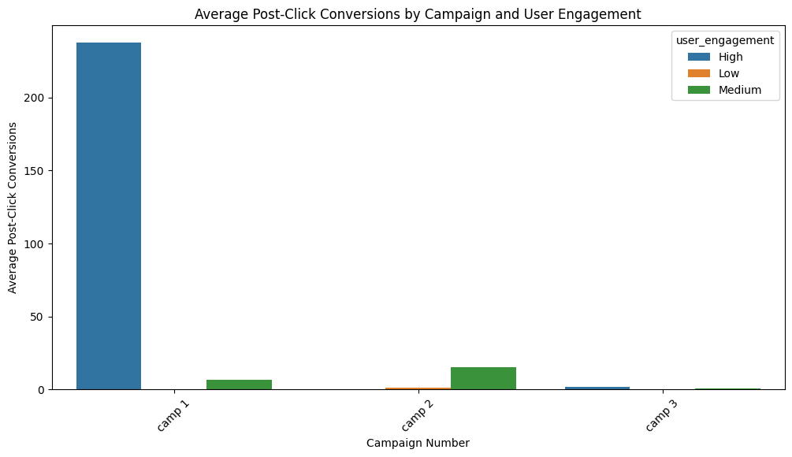
Q20. HOW DOES THE EFFECTIVENESS OF CAMPAIGNS VARY THROUGHOUT DIFFERENT USER ENGAGEMENT TYPES IN TERMS OF POST-CLICK CONVERSIONS?
Here, high user engagement in terms of post-click conversions is in campaign no.1 but there are significantly low in Campaign Number 2 and 3 based on user engagement in high, medium and low enrollment as well.

